Slide 1
Green University of Bangladesh
Department of Computer Science & Engineering
Subject: Algorithms
Course Code:CSE-205
Presentation topic :Complexity of Algorithms
Submitted To:
Name :Jargis Ahmed
Designation : Lecturer
Department : CSE
Green University of Bangladesh
Submitted by :
Name : Nazifa Alam Nowrin
ID : 193002103
Section : DC
Green University of Bangladesh

Slide 2
Outline:
Definition of complexity of algorithm
Measurement of the performance of an algorithm
Types of algorithm
Asymptotic Notation
Example

Slide 3
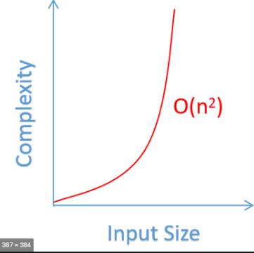
What is complexity of algorithm?

Slide 4
Measurement of the performance of an algorithm :
1. Space complexity
2. Time complexity

Slide 5
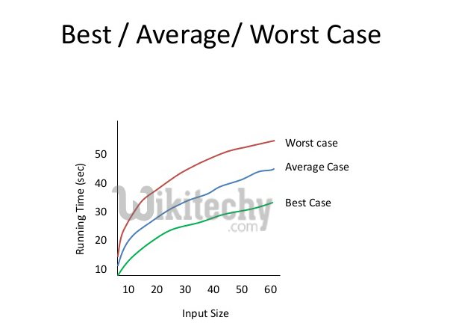
Types of algorithm:

Slide 6
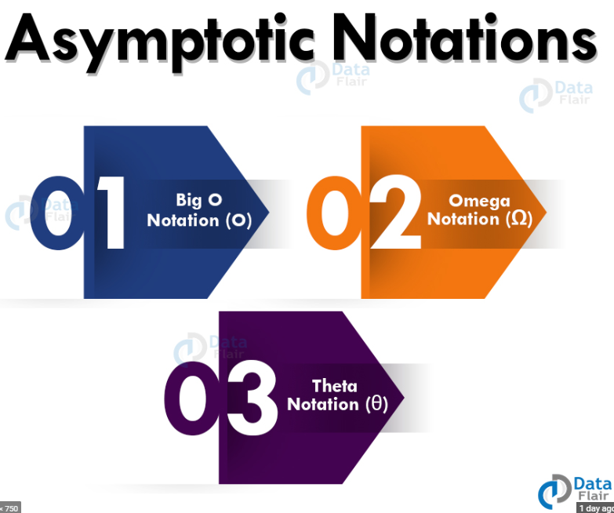
Asymptotic Notation:

Slide 7
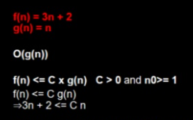
Example:

Slide 8
Thank you

